Slide 1



HBP Team Case - Majid Al Futtaim
MIS 581: Woo Sox Team
Allyson Bernard
Shubham Chaudhary
Jayesh Haryani
Harsh Deshpande

Slide 2
Agenda
SWOT Analysis for MAF
Driving MAF’s Strategic Vision
Communicating with MAF Stakeholders
Actions I would Recommend to IT and Business Cultures
Assess your IT Talent
Handle IT Knowledge Gaps
Importance of IT Governance Model and Controls
Data Leak Approach
Conclusion
References

Slide 3
SWOT Analysis for MAF
Threats
Strengths
Competition
Regulatory Compliance
Technological Disruption
Data Analytics Capabilities
Digital Transformation
Advanced Technology Infrastructure
Talent Acquisition
Personalized Customer Experience
New Revenue Streams
Innovation
Market Expansion
Dependency on Data
Integration Challenges
Cybersecurity Risks
Opportunities
Weaknesses
Notes:
Q1) What IT Strengths, Weaknesses, Opportunities, and Threats (SWOT) do you see at MAF’s strategic vision with their end customers?
A1) Analyzing the IT strengths, weaknesses, opportunities, and threats (SWOT) at Majid Al Futtaim (MAF) in relation to their strategic vision with end customers:
Strengths: (current state)
1. Data Analytics Capabilities: MAF has invested in advanced analytics capabilities, enabling them to gather insights from vast datasets of millions of customers.
2. Digital Transformation: The organization has successfully undergone a digital transformation, enhancing their omnichannel customer experience and operational tools.
3. Advanced Technology Infrastructure: MAF has built a digital powerhouse with robust data, technology, and people as key enablers.
4. Talent Acquisition: The recruitment of experienced data and analytics experts demonstrates a commitment to building a skilled workforce in this domain.
Weaknesses: (current state)
1. Dependency on Data: Over-reliance on data-driven decision-making may lead to challenges in adapting to rapidly changing market dynamics.
2. Integration Challenges: Bringing together diverse business units and technologies under one unified lifestyle proposition may pose integration challenges.
3. Cybersecurity Risks: With the increasing digitization of operations, cybersecurity vulnerabilities may become a significant concern.
Opportunities: (future state)
1. Personalized Customer Experience: Leveraging data analytics for personalized omnichannel offers can enhance customer satisfaction and loyalty.
2. New Revenue Streams: Data-driven insights can lead to the creation of new verticals such as advertising and monetization of insights.
3. Innovation: Opportunities exist to innovate further in AI-driven personalized offers and automation of predictive actions leveraging AI.
4. Market Expansion: With a presence in 16 markets, MAF has the opportunity to leverage data analytics for market expansion and growth.
Threats: (future state)
1. Competition: Intense competition in the retail and lifestyle industry may require continuous innovation to stay ahead.
2. Regulatory Compliance: Changes in data privacy regulations may impact data collection and usage practices.
3. Technological Disruption: Rapid advancements in technology may necessitate ongoing investments to stay relevant and competitive.
Internal References:
- Jim Maholic, and Jud Brandt. IT Strategy : A 3-Dimensional Framework to Plan Your Digital Transformation and Deliver Value to Your Enterprise. Jim Maholic, 2019.
External References:
- “SWOT Analysis of Al-Futtaim Company - 1007 Words | Bartleby.” Www.bartleby.com, www.bartleby.com/essay/SWOT-Analysis-Of-Al-Futtaim-Company-FJ5D5QZ93G. Accessed 30 Mar. 2024.

Slide 4


Driving MAF's Strategic Vision
Vision:
Strategic Alignment
Collaboration
Data-Driven Decision Making
Talent Development
Innovation
Risk Management
Possible Risks:
Resistance to Change
Resource Constraints
Technology Integration Challenges
Data Security and Privacy
Notes:
Q2) How would you align your IT organization to support, influence, and drive MAF’s strategic vision? What are the risks you see in your approach?
A2) Aligning the IT organization to support, influence, and drive MAF's strategic vision involves the following steps:
1. Strategic Alignment: Ensure that the IT strategy is closely aligned with MAF's overall business strategy and objectives. IT initiatives should directly contribute to achieving the organization's strategic goals, such as enhancing customer experience, driving operational efficiency, and enabling innovation.
2. Collaboration: Foster strong collaboration between IT and business units to understand their needs, challenges, and opportunities. IT should proactively engage with stakeholders to identify areas where technology can add value and drive business outcomes.
3. Data-Driven Decision Making: Promote a data-driven culture within the organization by leveraging analytics to generate insights that inform strategic decisions. Encourage the use of data to personalize customer experiences, optimize operations, and drive growth.
4. Talent Development: Invest in developing IT talent with expertise in areas such as data analytics, digital transformation, and emerging technologies. Provide training and development opportunities to ensure that the IT team has the skills needed to support MAF's strategic vision.
5. Innovation: Encourage a culture of innovation within the IT organization, fostering creativity and experimentation to drive continuous improvement and stay ahead of market trends. Explore emerging technologies that have the potential to disrupt the industry and drive competitive advantage.
6. Risk Management: Implement robust risk management practices to identify and mitigate potential risks associated with IT initiatives. This includes cybersecurity risks, data privacy concerns, regulatory compliance, and technology disruptions. Develop contingency plans to address unforeseen challenges that may arise.
The risks that I see in my approach are:
1. Resistance to Change: Stakeholders within the organization may resist changes driven by IT initiatives, leading to implementation challenges and delays in achieving strategic objectives. In this case I will have to guide my peers through the 7 stages of change from resistance to acceptance. Basicall, I have to drive change with intent
2. Resource Constraints: Limited resources, both in terms of budget and talent, may hinder the IT organization's ability to effectively support MAF's strategic vision. Prioritization of initiatives and resource allocation is crucial.
3. Technology Integration Challenges: Integrating new technologies with existing systems and processes can be complex and may lead to disruptions if not managed effectively.
4. Data Security and Privacy: With the increasing focus on data-driven decision-making, ensuring data security and compliance with privacy regulations is essential to mitigate risks related to data breaches and regulatory non-compliance.
Internal References:
- Roberts, Dan. Unleashing the Power of It. Wiley, 2013.
External References:
- “Majid al Futtaim’s New Formula for Growth | McKinsey.” Www.mckinsey.com, www.mckinsey.com/capabilities/growth-marketing-and-sales/our-insights/majid-al-futtaims-new-growth-formula-innovate-fast-stay-ahead-work-the-ecosystem.

Slide 5

Communicating with MFA Stakeholders
To the Top Leadership:
Outline the data governance program and its risk mitigation aspects so it can be minimized.
Outline the next phase of the roadmap.
To Employees:
Get their input on high-impact areas where analytics can unlock the values which would use to grow the businesses.
Make it a shared journey by seeking Their feedback.
Notes:
To ensure effective communication of alignment to all internal stakeholders at Majid Al Futtaim (MAF), the following strategies can be employed:
1. Establish Clear Communication Channels: Set up transparent and open communication channels to disseminate information regarding the company's strategic direction, objectives, and advancements in analytics-driven transformation.
2. Provide Regular Updates and Progress Reports: Furnish stakeholders with frequent updates and progress reports on analytics initiatives to keep them abreast of the impact of data-driven strategies on business operations.
3. Foster Engagement and Involvement: Actively involve stakeholders at all organizational levels in the analytics transformation journey. Encourage their feedback, ideas, and participation to instill a sense of ownership and alignment with the company's goals.
4. Customize Communication Approaches: Tailor communication methods to accommodate the preferences and requirements of diverse stakeholder groups. Utilize various mediums such as presentations, reports, workshops, and individual meetings for effective communication.
5. Showcase Success Stories: Share compelling success stories and case studies illustrating the favorable outcomes of analytics initiatives. This can bolster confidence and garner support for data-driven decision-making across the organization.
6. Offer Training and Education: Conduct training sessions and educational programs to enhance stakeholders' understanding of the value proposition of analytics and its relevance to their respective roles and functions within the organization.
7. Promote Transparency and Accountability: Cultivate a culture of transparency and accountability by clearly delineating roles, responsibilities, and expectations related to analytics initiatives. Encourage stakeholders to take ownership of their contributions to the transformation process.
By implementing these strategies, MAF can effectively communicate alignment to all internal stakeholders, fostering a unified understanding and commitment to the company's analytics-driven transformation journey.
External reference- “Majid al Futtaim Malls, Hotels & Lifestyle Brands.” Majid al Futtaim, www.majidalfuttaim.com/.
‌

Slide 6
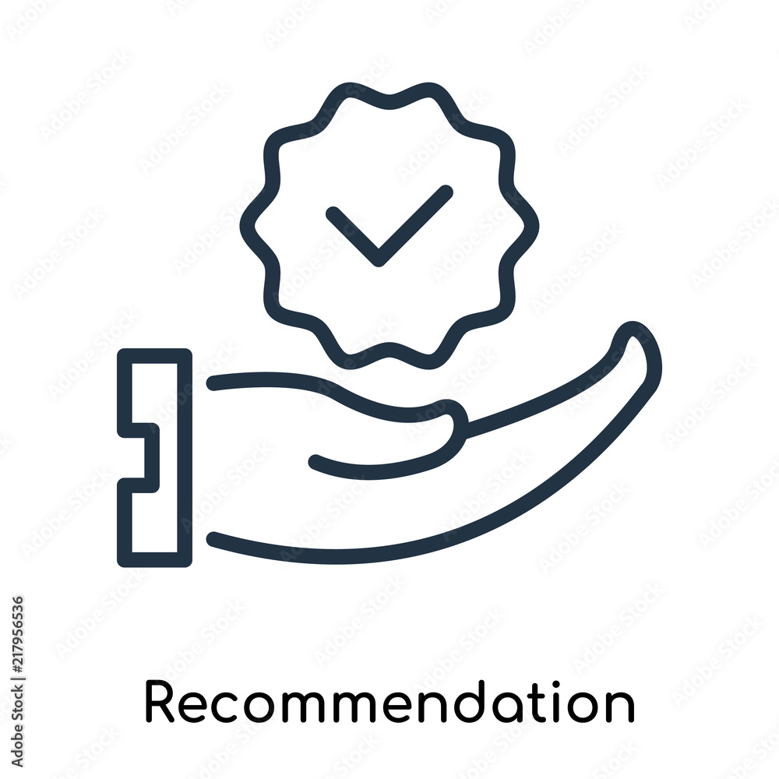
Actions I would recommend to IT and Business cultures-
IT Culture Assessment:
Evaluate the existing IT infrastructure, data governance policies.
Understand the IT team's receptiveness and readiness for change.
Business Culture Assessment:
Conduct surveys and interviews.
Test-and-learn mindset.
Notes:
Assessing the IT and Business cultures at Majid Al Futtaim (MAF) is essential for gauging the organization's readiness for analytics-driven transformation. Here's a breakdown of steps to evaluate and improve these cultures:
Culture Assessment:
1. Surveys and Interviews: Gather insights from employees across IT and Business departments through surveys and interviews. Assess attitudes towards data-driven decision-making, collaboration, and innovation.
2. Observation and Analysis: Analyze interactions, workflows, and communication within IT and Business teams to identify cultural norms and behaviors affecting analytics adoption.
3. Feedback Sessions: Organize feedback sessions or focus groups for employees to share perspectives on existing culture, challenges, and opportunities.
4. Culture Assessment Tools: Utilize frameworks like the Competing Values Framework or Denison Organizational Culture Model to assess alignment between IT and Business cultures.
Actions After Culture Assessment:
1. Identify Cultural Gaps: Analyze assessment findings to pinpoint disparities between current and desired cultures supporting analytics initiatives.
2. Define Cultural Objectives: Establish clear objectives aligned with strategic goals and analytics requirements, focusing on traits like data-driven decision-making and collaboration.
3. Communication and Training: Communicate cultural importance and offer training to help employees embrace desired changes.
4. Leadership Role Modeling: Ensure leaders exemplify desired cultural behaviors and actively promote them.
5. Cross-Functional Collaboration: Foster collaboration between IT and Business teams to promote shared goals and effective communication.
6. Recognition and Rewards: Implement systems that reinforce desired cultural behaviors related to analytics adoption and innovation.
7. Continuous Monitoring and Feedback: Continuously monitor cultural shifts, gather feedback, and adjust strategies as needed to maintain alignment with strategic objectives.
Through thorough assessment and targeted action, MAF can cultivate an environment conducive to successful analytics-driven transformation, promoting innovation and collaboration across IT and Business functions.
Personal story- Early in my career, I joined a company where IT was seen merely as a support function, isolated from the core business. There was a clear divide between the tech experts and the business stakeholders. It was a culture where communication gaps led to misunderstandings, delays, and missed opportunities.
But I believed in a different approach. I valued collaboration, transparency, and understanding between IT and business teams. So, I started small, initiating conversations, bridging gaps, and demonstrating the value IT could bring to achieving business objectives.

Slide 7


Assess your IT Talent
Notes:
How would you assess your IT talent to deliver on this new strategy?
Establish an understanding around what skills are need to deliver the new strategy.
Use all three assessment options
Consider your current employee and their skills – Ideally there's a company-wide database that allows managers to see this information on a broadscale at the very least.
Consider employees that have a similar or transferable skillset. Could folks be re-assigned to a new role? Ideally they would have an interest in this role change
Ideally the existing culture has a focus on employee progression and Career Conversations are already happening. Information about transferable skills or interest in changing may be shared anecdotally with supervisors and leadership.
Develop a plan, shift folks into the new role structure, provide the appropriate compensation. This will help keep folks engaged and satisfied with their employment.
Outside Source:
Capgemini. The Digital Talent Gap Are Companies Doing Enough. 2017.
InClass Resource:
Hub, The WPI. “The WPI Hub | Discover Canvas.” The WPI Hub, canvas.wpi.edu/courses/59603/files/6236777?module_item_id=1019424. Accessed 31 Mar. 2024.
‌Jim Maholic, and Jud Brandt. IT Strategy : A 3-Dimensional Framework to Plan Your Digital Transformation and Deliver Value to Your Enterprise. Jim Maholic, 2019.
Personal Story:
When presented with a recent promotion, I had the opportunity to stay within my current team or switch to a different department that was developing a new team. This new team would use similar technologies to what I use, but would come with new a new set of goals, management, internal culture, and general expectations. While I opted to decline the offer and decided to stay and get promoted within my current area, I was grateful that these conversations were happening. Had the option been presented while in a different role or on a different team, I'd have loved the opportunity. It was also a great way for the organization to keep headcount numbers consistent while giving resources to a new area.
‌

Slide 8
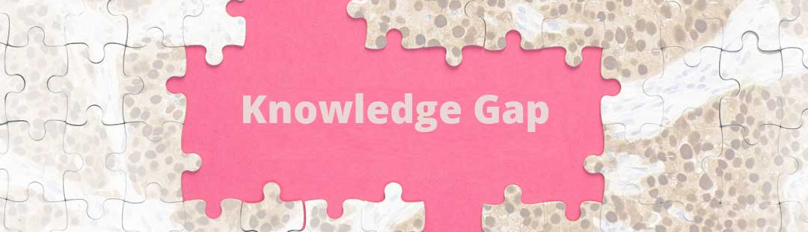

Upskilling
Identify underutilized staff
Provide "On the job" training
Hire Outside Talent
Identify skill requirements
Change Management Plan
Foster a collaborative culture
Focus on learning and using new skills
Consider Full Time staff and Consultants
Notes:
How would you handle gaps in your IT talent? What are your planned approaches when you find gaps in your organization for this transformation?
Upskilling – Consider bringing in consultants for training
New hires – Consider skills needed and bring in the folks with the right skillset. This could be new full time employees or outside consultants. Consultants can provide training and guidance to ease the transition
Change Management
Culture – Needs to be approachable, coachable, communicative
Personal Story:
When WPI brought Salesforce in a decade ago, they had a number of employees that could be repurposed to work on this new system implementation, but even still they needed to bring on outside consultants to get WPI started with some initial custom configurations and then created a handful of new full-time positions to help maintain the system going forward. By brining in all these different resources, WPI was able to set Salesforce up for success, and also demonstrate the importance that Salesforce was expected to have going forward for university operations. Simply bringing in the different types of support would have had no value if there wasn't a supportive culture focused on the success of Salesforce.
Outside Source:
“How to Address the Skills Gap.” Www.shrm.org, www.shrm.org/topics-tools/tools/how-to-guides/how-to-address-skills-gap.
“Upskilling and Reskilling: Addressing the Skills Gap in the Workforce.” Www.linkedin.com, www.linkedin.com/pulse/upskilling-reskilling-addressing-skills-zlt2f/. Accessed 31 Mar. 2024.
‌
Internal References:
- Roberts, Dan. Unleashing the Power of It. Wiley, 2013.
‌

Slide 9
Importance of IT Governance Model and Controls
Alignment with Business Objectives
Risk Management and Compliance
Enhanced Decision Making and Efficiency
Value Creation and Innovation
Notes:
Alignment with Business Objectives: Highlight how effective IT governance ensures that IT strategies are closely aligned with overarching business objectives, enhancing the organization's ability to achieve its goals and maximize ROI on IT investments.
Risk Management and Compliance: Emphasize the role of IT governance in managing risks associated with IT operations, cybersecurity, data privacy, and regulatory compliance. Discuss how robust governance frameworks help mitigate risks and ensure adherence to industry standards and regulations.
Enhanced Decision-making and Efficiency: I'll illustrate how clear governance structures and processes facilitate more informed decision-making, streamline IT operations, and improve overall organizational efficiency. I will show how defined roles, responsibilities, and workflows contribute to the smoother execution of IT projects and initiatives.
Value Creation and Innovation: I will explain how effective IT governance fosters a culture of innovation by optimizing resource allocation, encouraging experimentation, and promoting collaboration across departments. I would highlight how it enables organizations to leverage emerging technologies and data-driven insights to drive innovation and gain competitive advantage.
These points provide a concise overview of the benefits and importance of implementing robust IT governance models and controls within an organization.
Key Stakeholders and Roles:
IT Steering Committee: Comprising senior executives and business leaders.
Chief Information Officer (CIO): Responsible for aligning IT strategies with business goals.
Chief Data Officer (CDO): Overseeing data governance and analytics initiatives.
IT Security Officer: Managing IT security controls and policies.
Business Unit Leaders: Involved in decision-making related to IT investments and projects.
Internal Audit: Providing independent assurance and oversight of IT governance practices.
Personal Story
In a retail company's digital transformation journey, a significant data breach shook operations. Unauthorized access to customer data highlighted the critical need for robust IT governance. This wake-up call emphasized aligning IT strategies with business goals, stringent risk management, and clear decision-making processes. Strengthened governance structures fostered collaboration and innovation, driving a resilient digital future. The incident, though challenging, spurred positive change, reinforcing the vital role of IT governance in safeguarding data, mitigating risks, and ensuring organizational success.

Slide 10
Data Leak Approach
Enhanced Data Quality Assurance
Improved Governance and Compliance
Facilitated Data Discovery and Understanding
Enhanced Analytical Capabilities
Real-time Decision Support
Notes:
Enhanced Data Quality Assurance: Implementing robust data quality checks and cleansing processes ensures the accuracy and reliability of insights derived from the data lake.
Improved Governance and Compliance: The establishment of a comprehensive data governance framework defines clear ownership, access controls, and compliance standards, ensuring data integrity and security.
Facilitated Data Discovery and Understanding: Enhanced metadata management practices and implementation of a data catalog streamline data discovery and understanding, empowering analysts and data scientists to access relevant data efficiently.
Enhanced Analytical Capabilities: Integration of advanced analytics tools and technologies, including machine learning algorithms and predictive models, enables MAF to derive deeper insights and unlock predictive capabilities from their data lake.
Real-time Decision Support: Implementation of real-time data processing capabilities enables MAF to make informed decisions based on the latest data streams, fostering agility and responsiveness in their business operations.
These points highlight the value of the proposed enhancements in strengthening MAF's data lake approach and advancing its analytics capabilities for better business outcomes.

Slide 11
Conclusion
Strategic Vision and Leadership
Transformational Initiatives
Business Impact
Future Direction
Notes:
Strategic Vision and Leadership: CEO Alain Bejjani led the initiative to leverage data analytics for enhancing customer experiences and driving growth.
Transformational Initiatives: Advanced Analytics Centre of Excellence and data lakes facilitated comprehensive insights and informed decision-making across the organization.
Business Impact: Tangible outcomes included revenue growth and improved customer satisfaction, driven by analytics-driven strategies like assortment optimization.
Future Directions: Commitment to continual innovation in data optimization to maintain competitiveness, foster resilience, and unlock future growth opportunities.

Slide 12
References
“How to Address the Skills Gap.” Www.shrm.org, www.shrm.org/topics-tools/tools/how-to-guides/how-to-address-skills-gap.
“Upskilling and Reskilling: Addressing the Skills Gap in the Workforce.” Www.linkedin.com, www.linkedin.com/pulse/upskilling-reskilling-addressing-skills-zlt2f/. Accessed 31 Mar. 2024.
Roberts, Dan. Unleashing the Power of It. Wiley, 2013.
“Majid al Futtaim’s New Formula for Growth | McKinsey.” Www.mckinsey.com, www.mckinsey.com/capabilities/growth-marketing-and-sales/our-insights/majid-al-futtaims-new-growth-formula-innovate-fast-stay-ahead-work-the-ecosystem.
“SWOT Analysis of Al-Futtaim Company - 1007 Words | Bartleby.” Www.bartleby.com, www.bartleby.com/essay/SWOT-Analysis-Of-Al-Futtaim-Company-FJ5D5QZ93G. Accessed 30 Mar. 2024.
Jim Maholic, and Jud Brandt. IT Strategy : A 3-Dimensional Framework to Plan Your Digital Transformation and Deliver Value to Your Enterprise. Jim Maholic, 2019.
Hub, The WPI. “The WPI Hub | Discover Canvas.” The WPI Hub, canvas.wpi.edu/courses/59603/files/6236777?module_item_id=1019424. Accessed 31 Mar. 2024.
Capgemini. The Digital Talent Gap Are Companies Doing Enough. 2017.

Slide 13
Required Case Study Check List
Case Study Items | Yes/No | What slide(s) is your proof of this in your submission? | Proof in your the slide(s) or notes section?
1. Did you review the detailed rubric after you completed this assignment to make sure you covered everything? | Yes | N/A | N/A
2. Did you review all detail/specific and overarching questions in the assignment to make sure you covered everything? | Yes | N/A | N/A
3. Did you do a conclusion slide(s) to answer all required conclusion items/questions? | Yes | 11 | Yes
4. Did you a create reference slide in the proper MLA format? | Yes | 12 | Yes
5. Did you test all your links for references and/or files so a reader can just click to see your materials? | Yes | N/A | N/A
6. Did you proof-read all your slides, attachments, links, notes, etc. before your submission? | Yes | N/A | N/A
7. For your reference slide, did you have internal and external resources/materials to our course? | Yes | 3,4,5,7,8 | Yes
8. Did you share your own personal stories, thoughts and explain the “Why” your answers are important to you? | Yes | 6,7,8,9 | Yes

